Slide 1


LOGIC
Logic is a science of the necessary laws of thought ...
(Kant, 1785)

Slide 2

Why study this chapter?
Remove ambiguity of human languages.
Basis of all mathematical reasoning, and of all automated reasoning.
Important in design of computing machines.
Ubiquitous in computer science.

Slide 3

Learning objectives
Apply propositional logic to mathematical thinking.
Verify equivalence of two propositions.
Find the negation of a compound proposition.
Translate between English sentences and logical expressions.
Use rules of inference to produce a valid argument.

Slide 4

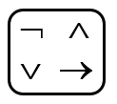

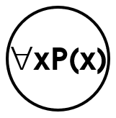

Foundations of Logic
Propositional logic
Operators
Equivalence rules
Predicate logic
Rules of Inference
Design of digital electronic circuits.
Express conditions in programs.
Query to databases & search engines.
Express and manipulate statements in mathematics and computer science.
Produce valid arguments.

Slide 5
Propositions
Proposition: a declaration that is true or false but not both.
Proposition | NOT a proposition
p: Hanoi is the capital of Vietnam. q: 1 + 1 = 3. h: The moon is made of green cheese. | What time is it? Read this chapter carefully. x + 1 = 2. Oh no!
✓

Slide 6
Operators/connectives
∧
∨ →
Compound Proposition | Symbol
My PC does not run Linux. | ¬
He is young and strong. | ∧
You will take the final exam on Friday or Saturday. | ⊕
Experience with C++ or Java is required. | ∨
I will be shot if I know. | →
I go to cinema if and only if it rains. | ★

Slide 7
Some Alternative Notations

Slide 8
negation of a proposition
➢
¬p: negation of p
Proposition | Negation
p: Hanoi is the capital of Vietnam. q: 1 + 1 = 3. | ¬p: Hanoi is not the capital of Vietnam. ¬q: 1 + 1 ≠ 3.

Slide 9
Truth table
True = T = 1
False = F = 0
The Truth Table for the Negation of a Proposition.
p | ¬p
T | F
F | T
p : 1 + 1 = 3
¬p : 1 + 1 ≠ 3

Slide 10
conjunction of propositions
∧
p ∧ q: the conjunction of p and q Read: p and q
“p and q” is true if p = T, q = T and “p and q” is false otherwise
p | q | p ∧ q
T | T | T
T | F | F
F | T | F
F | F | F
The only
TRUE case

Slide 11
examples
∧
Nam is young (y) and strong (s).
In symbols: y ∧ s
I know (k) but I say nothing (s).
In symbols: k ∧ s

Slide 12
disjunction of propositions
∨
p∨q: the disjunction of p and q
Read: p or qrue if p = T, q = T
and “p and q” is false otherwise
p | q | p ∨ q
F | F | F
T | F | T
F | T | T
T | T | T
The only
FALSE case
p: 3 > 2
q: 1 > 2
p∨q: 3 > 2 or 1 > 2

Slide 13
Exclusive Or
⊕
Nickname: XOR
Symbol: ⊕
p | q | p ⊕ q
F | F | F
F | T | T
T | F | T
T | T | F
DIFERENT FROM ∨

Slide 14
Natural language is AMBIGUOUS // tối nghĩa
Sack Mourinho OR I will kill my cat ⊕
Lunch includes soup OR salad ∨
p | q | p OR q
F | F | F
F | T | T
T | F | T
T | T | ?
∨ : p or q
⊕ : p or q but not both

Slide 15
conditional statement
⇨
p → q
Read: if p, then q
Nickname: implication
Ex. ” is false otherwise
antecedent
consequent
p ⇨ q
s | h | s → h
It is sunny. | It is hot. | If it is sunny, then it is hot.

Slide 16

Quiz


If I have wings, then I can fly.
If my duck has wings, it can fly.

F  F T
T  T T
F  T T
T  F F

The only
FALSE case
A useful way to understand:
think of an obligation or a contract.

Slide 17
Quiz


Suppose p  r is false, find the value of each of these propositions:
r  p
(¬p) ∨ r
p ⊕ r
(¬r)  p

Slide 18
Fifty shades in natural languages
Sufficient condition
necessary condition
p implies r
p only if r
r is necessary for p
p is sufficient for r
⇨
p ⇨ r

Slide 19

Rewrite the statements in form If ___, then ___
⇨
To get tenure as a professor, it is sufficient to be world famous.
➔ If you are world famous, then you will get tenure as a professor.
It is necessary to have a valid password to log on to the server.
If you log on to the server, then you have a valid password.
Studying is sufficient for passing.

Slide 20

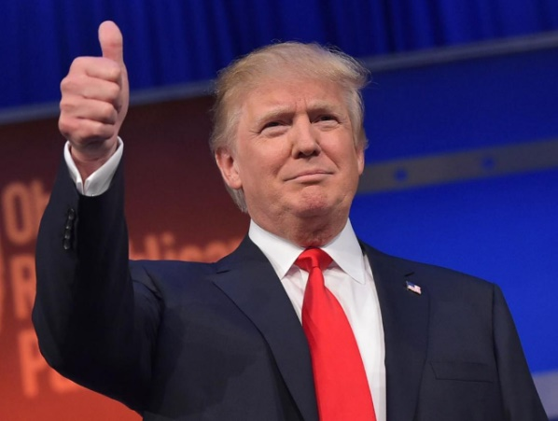
Biconditional statement
⬄
p ↔ q
Read: p if and only if q
p | q | p ↔ q
F | F | T
F | T | F
T | F | F
T | T | T
A shape is called a square
if and only if
it has 4 right angles.
2016

Slide 21
Natural language is AMBIGUOUS
Rarely used in common language.
Catch me if you can // if = if and only if
In math & logic, p → q ≠ p  q
⬄

Slide 22
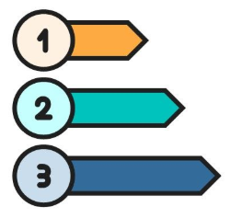
precedence
(1) In parentheses from inner to outer
(2) ¬
(3) ∧
(4) ∨
(5) →
¬p∨q∧r means (¬p)∨(q∧r)

Slide 23
Logical equivalences - intro
a, b, c: real numbers
a + b = b + a // commutative law
a(b + c) = ab + ac // distributive law
r, s, t: propositions
r ∨ s ≡ s ∨ r
r∧(s ∨ t) ≡ r∧s ∨ r∧t

⬧

Slide 24
Logical Equivalence
≡
He is young and strong ≡ He is strong and young.
Commutative laws: p∧q ≡ q∧p, p∨q ≡ q∨p

Slide 25
Quiz
p ∨ T ≡ 
p ∧ p ≡ 
p ∧ F ≡ 
p ∧ ¬p ≡ 
¬(¬p) ≡ 

Slide 26
¬(p ∧ q) vs ¬p ∨ ¬q
≡
p | q | ¬ (p ∧ q) | ¬p | ¬q | ¬p ∨ ¬q
F | F | T | T | T | T
F | T | T | T | F | T
T | F | T | F | T | T
T | T | F | F | F | F
THESE TRUE VALUES AGREE

Slide 27
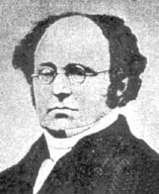

De morgan’s laws
A. De Morgan (1806-1871)
Ex. Find the negation of the statement
Bob knows Python and Java.
--------------------------------------------
In symbols: P ∧ J
Apply De Morgan law: $\overline{P ∧ J} ≡ \overline{P}$ ∨ $\overline{J}$
--------------------------------------------
➔ Bob does not know Python or Java.

Slide 28
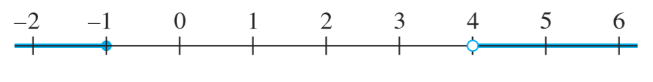

De morgan’s laws
Write the negation of
−1 < x ≤ 4.
−1 < x ≤ 4 means −1 < x and x ≤ 4.
Its negation is −1 ≮ x or x ❼ 4, which is eq. to −1 ≥ x or x > 4.
The negation is not −1 ≮ x and x ❼ 4.

Slide 29
quiz


p ∨ q ≡ ¬p  q
p ∧(p ∨ q) ≡ p
p  q ≡ q  p
p  q ≡ ¬p ∨ q
A  B ≡ ¬B  ¬A

Slide 30

Distributive laws
p∧(q ∨ r) ≡ (p ∧ q)∨(p ∧ r)
p∨(q ∧ r) ≡ (p ∨ q)∧(p ∨ r)

Slide 31

Important equivalences
De Morgan laws
A  B ≡ ¬A ∨ B
A  B ≡ ¬B  ¬A
Write a proposition equivalent to p  q using only p, q, ∧, and ¬.
Write a proposition equivalent to
(p  q)∧(¬p  q).

Slide 32
Predicates. quantifiers
4 is a prime. // proposition
x is a prime. // not a proposition
x is a prime // a predicate
Let P(x) be the statement x is a prime.
 P(3): 3 is a prime

Slide 33
Quiz


Let Q(w) be the statement that the word w contains the letter a. Find the truth value of each of these statements:
Q(false)
Q(true)
Q(happy)

Slide 34
Predicates. quantifiers
Some integers are primes.
In symbols: ∃xP(x) // P(x): integer x is prime
quantifier predicate

Slide 35
quantifiers
Every
Some
There exists
There is/are
All
Few
Each
Any
None
Many
∀
∃
Universal
quantifier
Existential
quantifier

Slide 36

Quiz

Let Q(x, y) be the statement x + y = xy, where x and y real numbers.
Find the truth value of each of these statements:
Q(2, 1)
Q(3, 1)
∀yQ(0, y)
∃xQ(x, 3)

Slide 37

Translating
∀
A
Let L(x, y) be the statement that x loves y, where the domain for both x and y consists of all people in the world. Use the given predicate and quantifiers to express each of these sentences.
Nam loves Minh.
L(Nam, Minh) L(Minh, Nam)
There is someone whom Tom loves.
∃yL(Tom, y)

Slide 38
Translating
∀
A
Let L(x, y) be the statement that x loves y, where the domain for both x and y consists of all people in the world. Express each of these sentences.
Everybody loves Alex.
Everybody loves somebody.
There is somebody whom everybody loves.

Slide 39

Negating
➢
Express the negations of these propositions using quantifiers, and in English.
Every student in this class likes mathematics.
Some students in this class do not like mathematics.
All students in this class have passed calculus.

Slide 40
Rules of inference
P
∴Q
Laws of thought
Rules for producing valid arguments
Rules for avoiding fallacies
Rules for making draws from a hypothesis

Slide 41
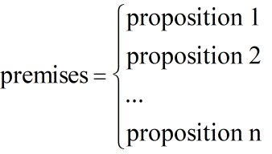
arguments
If apes are intelligent, then apes can solve puzzles.
Apes can solve puzzles.
Therefore, apes are intelligent.
Invalid
argument
When
‘premises ⇨ conclusion’
is always true, we have a valid argument
∴ conclusion

Slide 42
Modus pones
A ⇨ B
A
∴B
❶ If A, then B.
❷ A.
❸ Therefore, B.
Valid argument with false conclusion

Slide 43
Modus tollens
A ⇨ B
¬B
∴¬A
If this ﬁgure is a triangle, then the sum of its interior angles is 180°.
The sum of the interior angles of this ﬁgure is not 180°.
Therefore, this ﬁgure is not a triangle.
❶ If A, then B.
❷ ¬B
❸ Therefore, ¬A.
If logic is easy, then I am a monkey’s uncle.
I am not a monkey’s uncle.
Therefore, logic is not easy.

Slide 44
Other rules
❶ ⇨ ❷
❷ ⇨ ❸
❶ ∨ ❷
¬❶
❶ ∧ ❷
∴❶ ⇨ ❸
∴❷
∴❶
If I go to the movies, I won’t ﬁnish my homework. If I don’t ﬁnish my homework, I won’t do well on the exam tomorrow.
Therefore, if I go to the movies, I won’t do well on the exam tomorrow.
This real number is rational or it is irrational.
This real number is not rational.
Therefore, this real number is irrational.
Sandra knows Java and Sandra knows C++.
Therefore, Sandra knows C++.

Slide 45

fallacies

If this number is larger than 2, then its square is larger than 4.
This number is not larger than 2.
Therefore, the square of this number is not larger than 4.
If Jules solved this problem correctly, then Jules obtained the answer 2.
Jules obtained the answer 2.
Therefore, Jules solved this problem correctly.

Slide 46
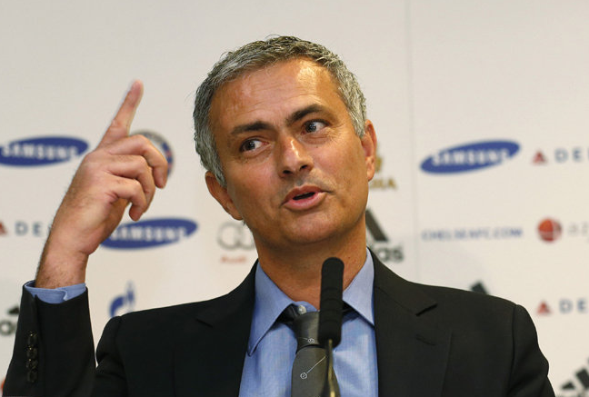

Valid or not
If you enjoy what you’re doing, you don’t lose your hair. He’s got a bald head. Guardiola doesn’t enjoy football.



Slide 47

Valid or not

Hắn chửi như những người say rượu hát. Giá hắn biết hát thì có lẽ hắn không cần chửi. Khổ cho hắn và khổ cho người, hắn lại không biết hát. Thì hắn chửi, cũng như chiều nay hắn chửi …
(trích Chí Phèo của nhà văn Nam Cao)


Slide 48

Quiz

If this number is larger than 2, then its square is larger than 4.
This number is not larger than 2.
Therefore, the square of this number is not larger than 4.


Slide 49
If Lin eats banana every day, then she is healthy.
Lin is not healthy.
Therefore, Lin does not eat banana every day.
If Sarah knows Java, then she knows C++.
Sarah doesn’t know C++.
Therefore, Sarah doesn’t know Java.



Slide 50
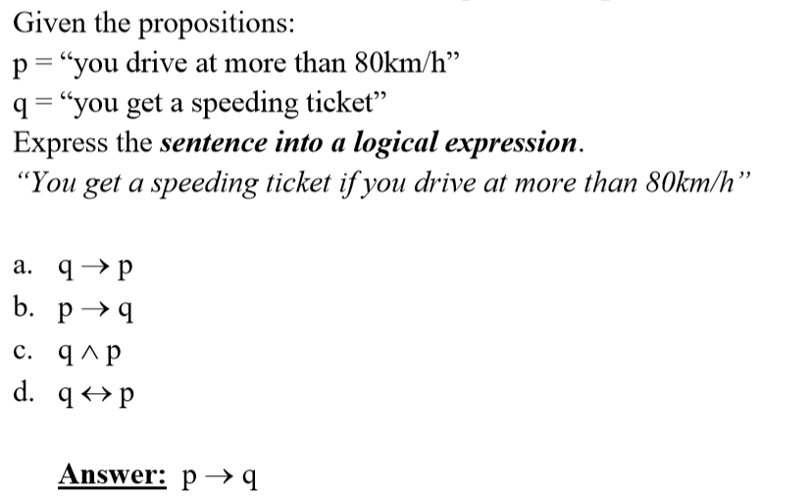
REVIEW QUESTIONS

Slide 51
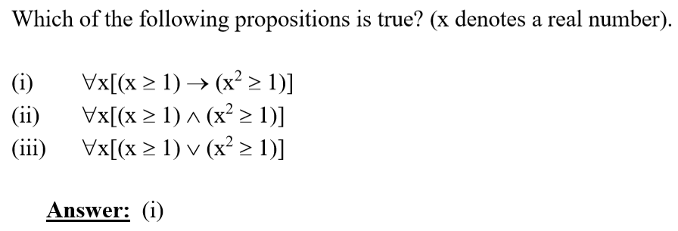

Slide 52
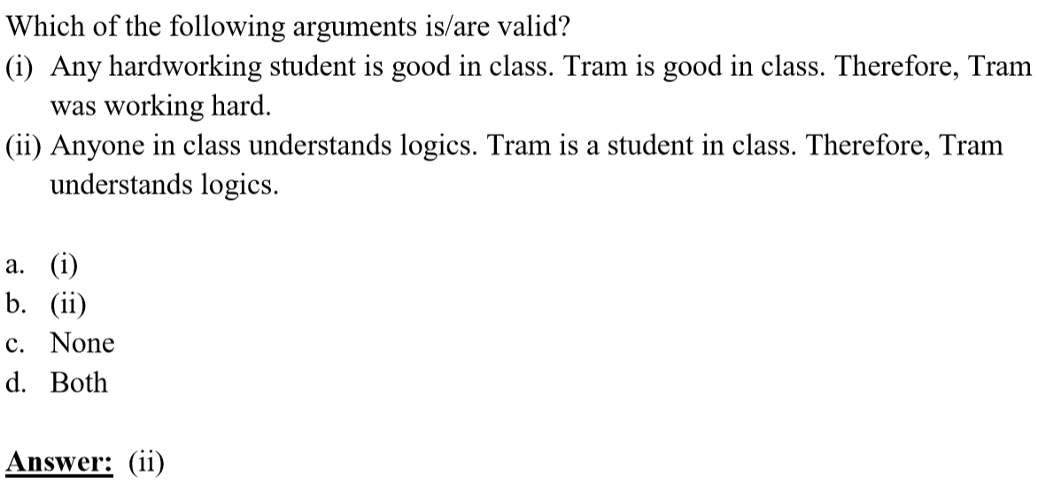

Slide 53
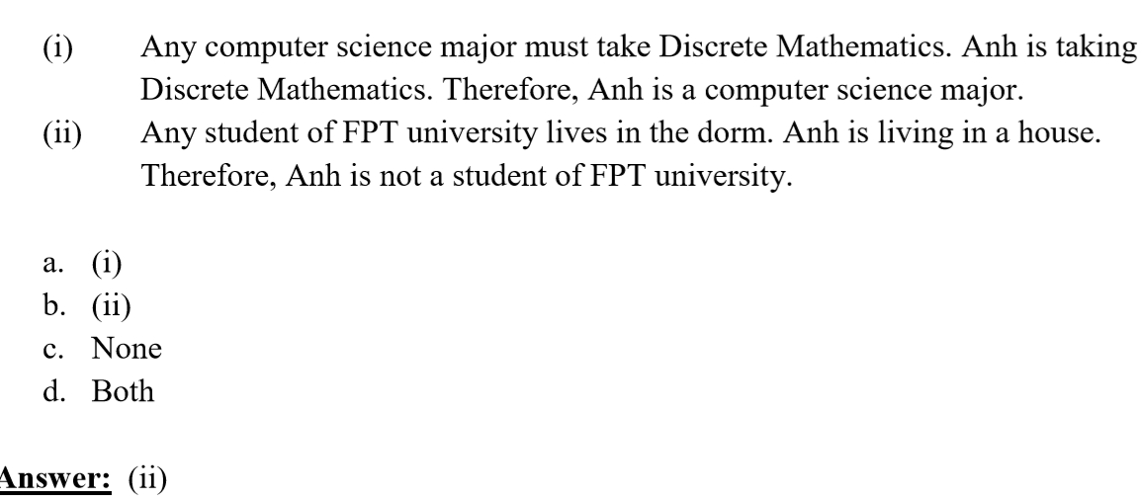

Slide 54
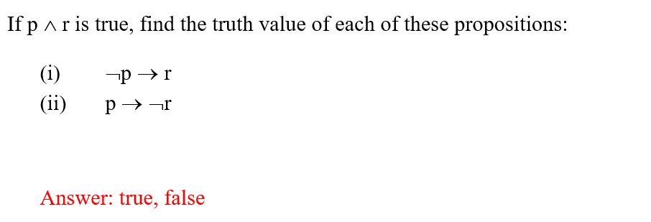

Slide 55
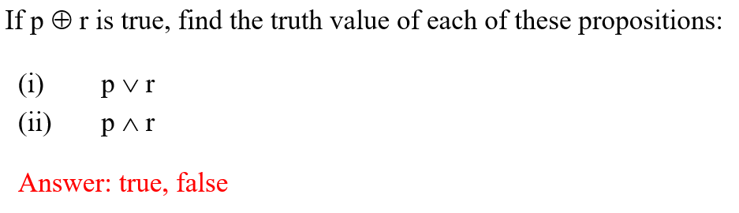

Slide 56
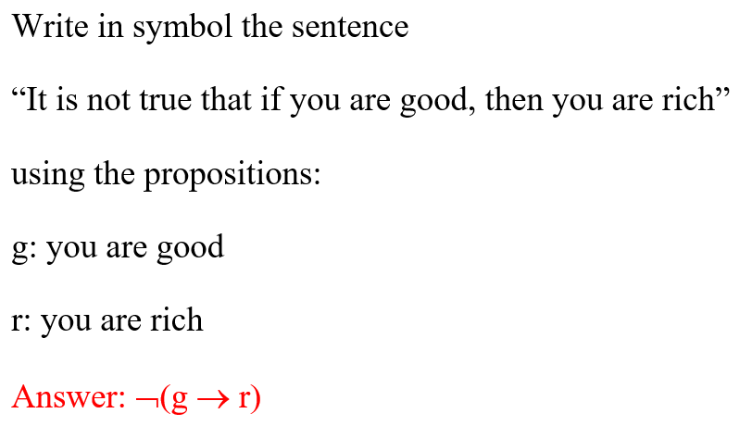

Slide 57
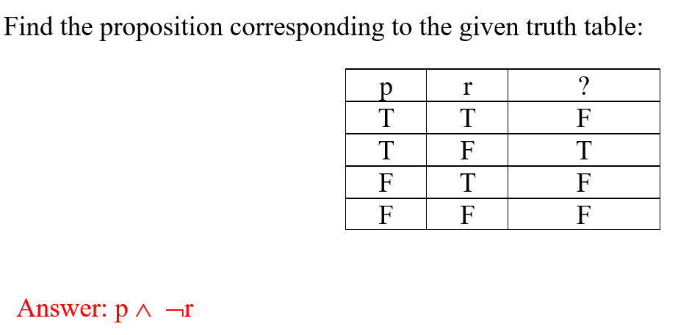

Slide 58
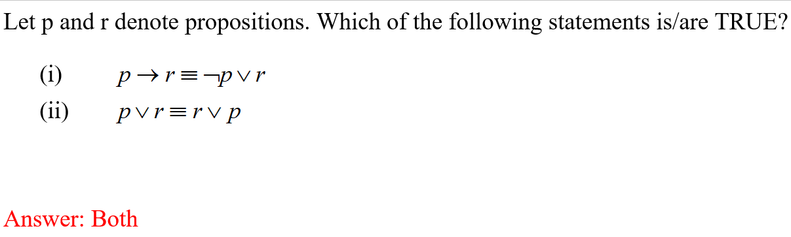

Slide 59
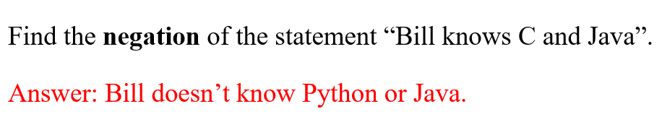

Slide 60
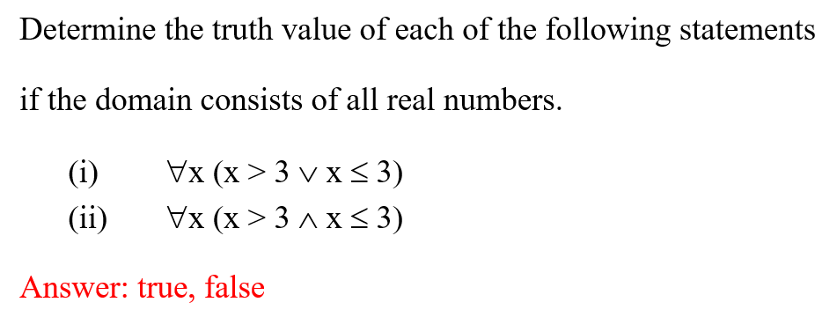

Slide 61
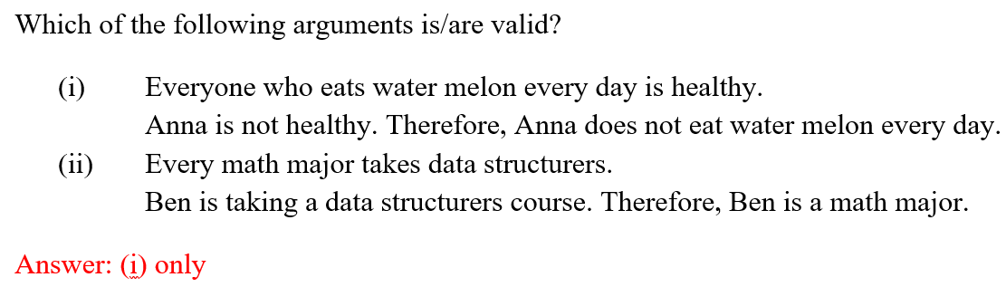

Slide 62
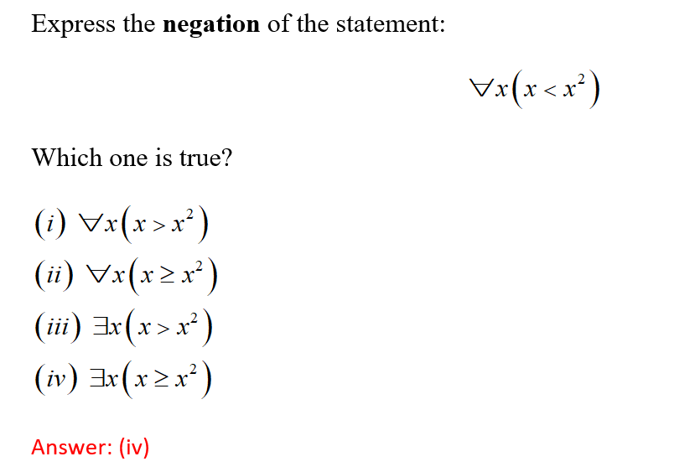

Slide 63
Summary
∑
Propositional logic
Logical equivalences
Predicates & Quantifiers
Rules of inference

Slide 64
THANKS

